Slide 1


Team – Team
Members – Rushikesh Kusuma

Slide 2
Data Cleaning and Preprocessing
Had an overview of the Excel sheets
Performed data cleaning
Performed data preprocessing
Verified all the given tables for any irregularities
Proceeded to Data Visualization for Analysis

Slide 3
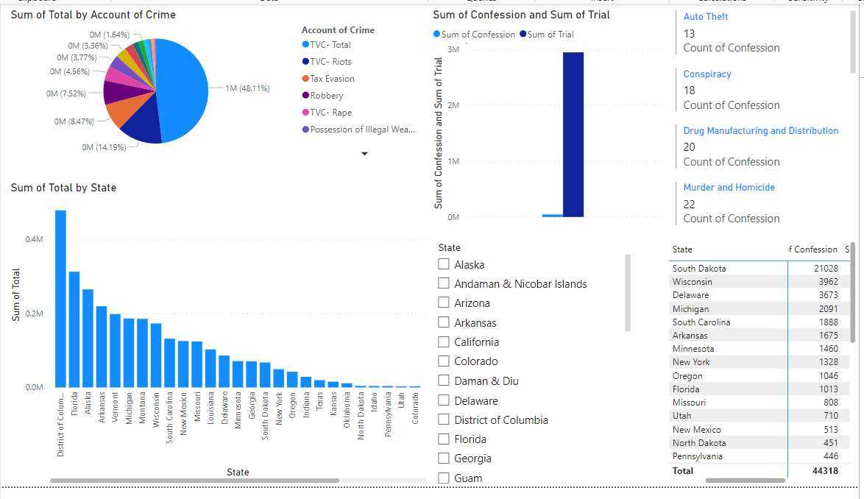
Trial of Violent Crimes

Slide 4
Analytical Conclusions
The District of Columbia has the highest total Crime among all the states.
In general the Confessions to Crimes are very low (around 1.5%)
But South Dakota is an exception to the above-mentioned statement. South Dakota corresponds to 47.44% of all the confessions despite representing around 2.25% of crime.

Slide 5
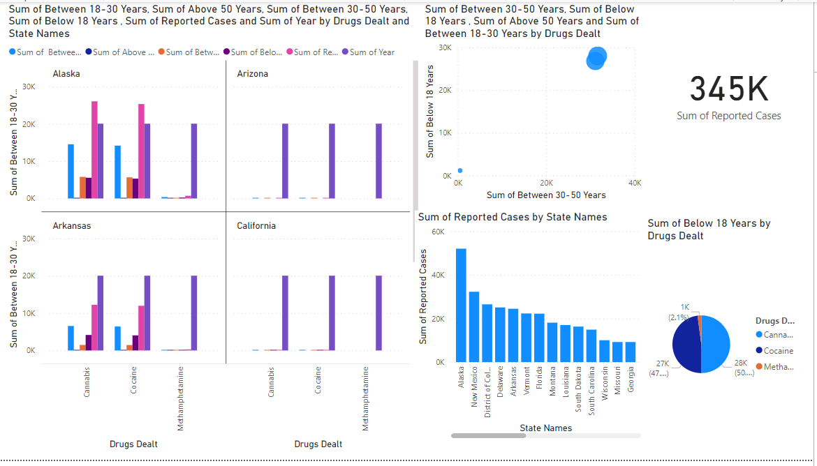
State Arrested Drugs

Slide 6
Analytical Conclusions
The most common Drugs Dealt are Cannabis and Cocaine
Alaska which represents just 0.2% of the US population is responsible for around 15.1% of all the cases.

Slide 7
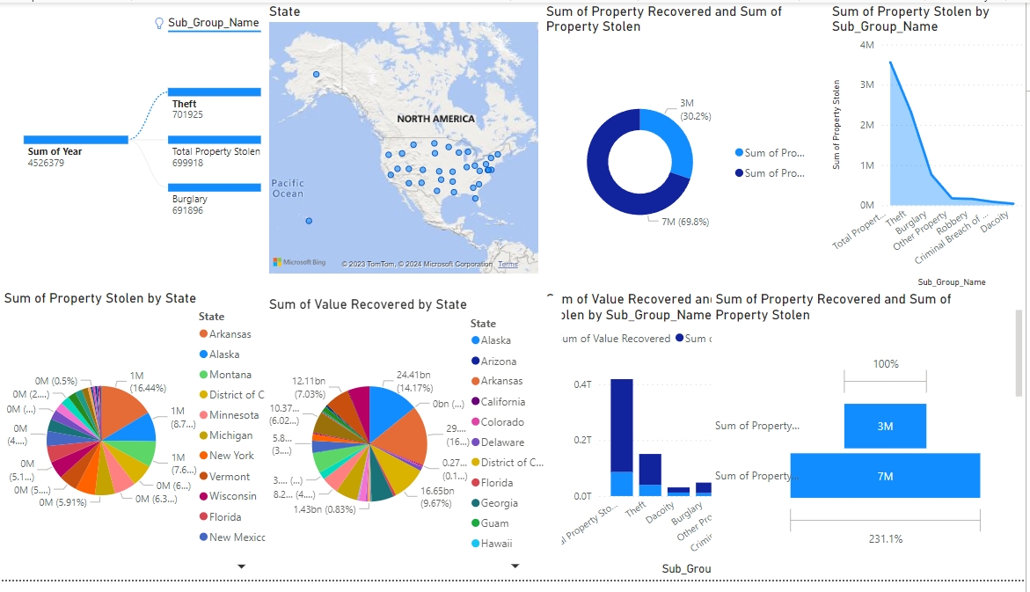
Property Stolen and Recovered

Slide 8
Analytical Conclusions
Around 30% of the property stolen got recovered
Arkansas is the state with the most amount of property stolen(16.44%) and value stolen(32%) with Arkansas representing 7.2% of US population
Alaska represents 5.15% of Value stolen but an impressive 14.17% of Value recovered.

Slide 9
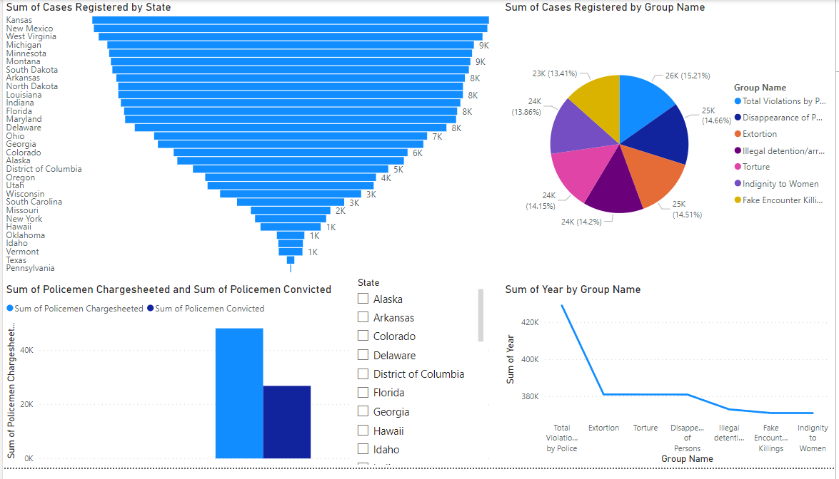
Human Rights Violation

Slide 10
Analytical Conclusions
Police Violation is the largest Human Rights Violation
Around 55.8% of Policemen charge-sheeted got convicted

Slide 11
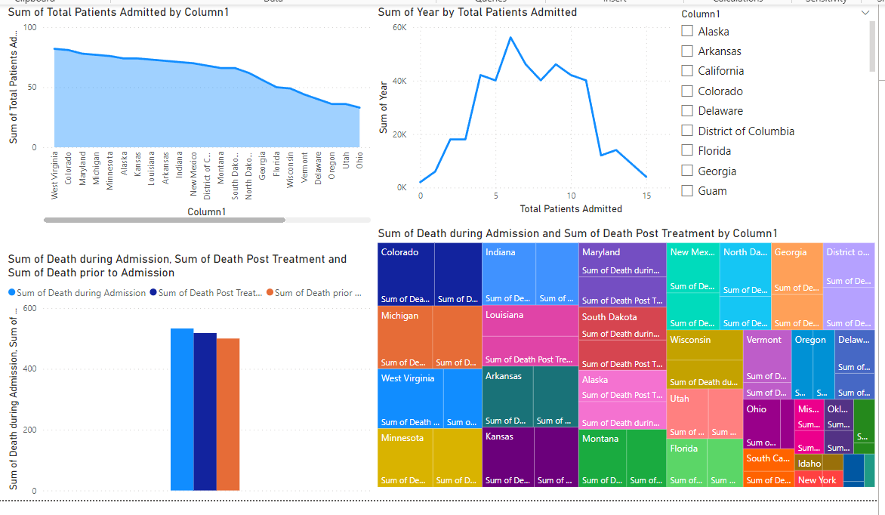
Death Timeline

Slide 12
Analytical Conclusions
No of deaths prior, during and post treatment are similar
The number of hospilizations have increased in the past but back to now.

Slide 13
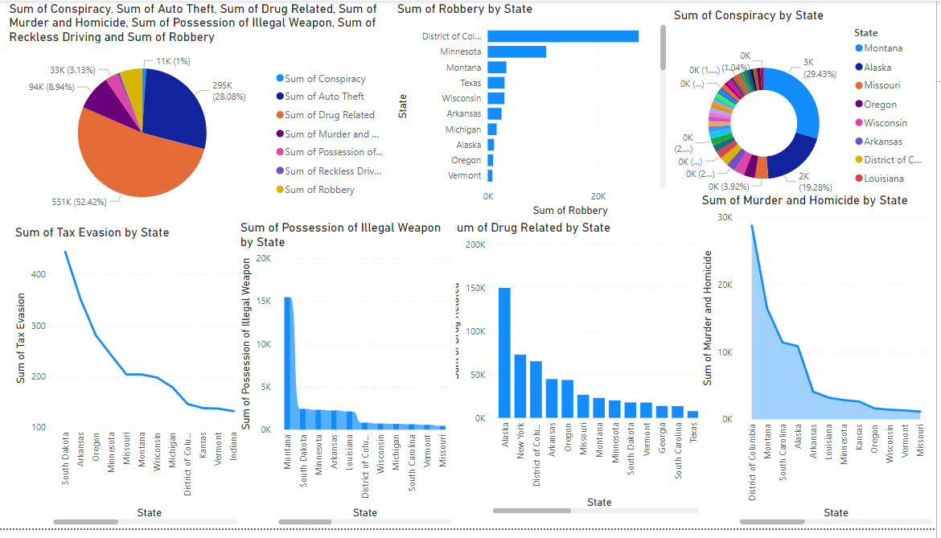
Crimes Committed

Slide 14
Analytical Conclusions
Drug Related crimes represent 52.4% of all the Crimes
South Dakota has an unusually high Tax Evasion rate
Alaska has an unusually high Drug related cases
Montana has an unusually high Conspiracy cases.
Columbia has an unusualy high Murder and Homicide rate
Montana has an extremely high rate of Possession of Illegal Weapons(44.6% of total)
Columbia has an unusually high Robbery rate.

Slide 15
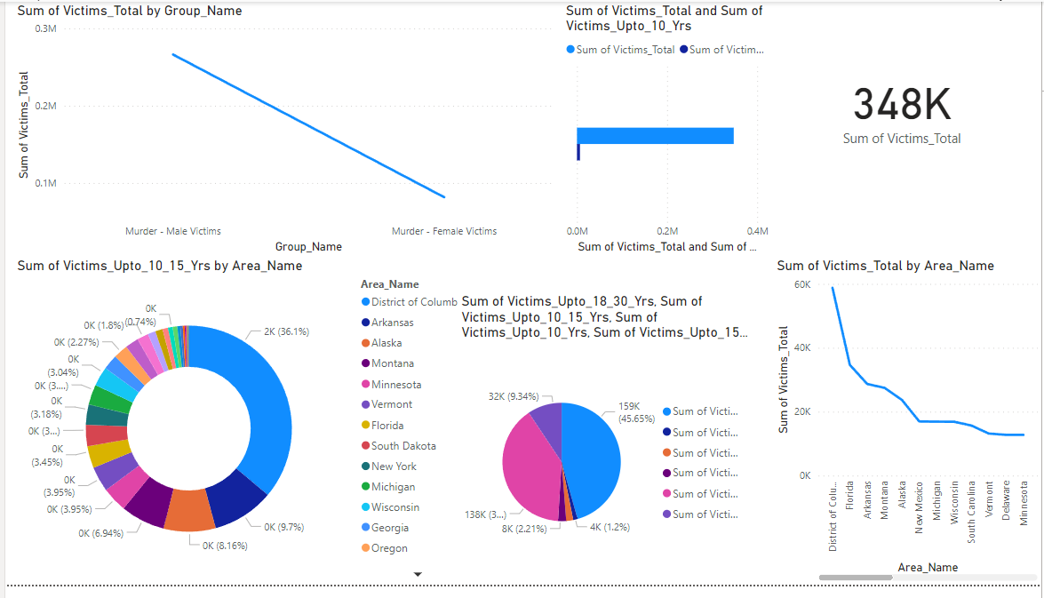
Crimes and Victim Age

Slide 16
Analytical Conclusions
Infants(Younger than 10 yrs) represent close to 2% of the total Victim Population
Columbia has the highest Victims Total with 16.9%.
The 30-50 age group consists of a majority of the Victim Category.
There are 3.26 male victims for every single female victim

Slide 17
Strategies to reduce crime
Boost community outreach initiatives to foster cooperation and trust, particularly in states with high crime rates like Alaska and the District of Columbia.
Launch public awareness efforts to inform people about the negative effects of tax evasion on society, particularly in South Dakota.
Promote neighborhood watch programs and the exchange of security information through neighborhood-based initiatives.
Create specialized programs to address the underlying causes and dismantle criminal networks in regions like Montana that have a high number of conspiracy cases.
Provide mentorship programs, after-school activities, and career training to keep youth involved in constructive activities and away from harmful influences.

Slide 18
Conclusion
From the analytics obtained from the data, the Government can look into the matter and take appropriate decisions on the governance.

Slide 19
Thank You

